Slide 1
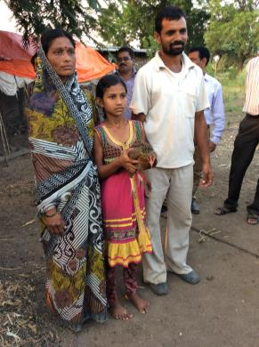
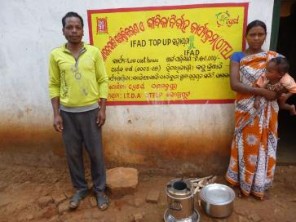
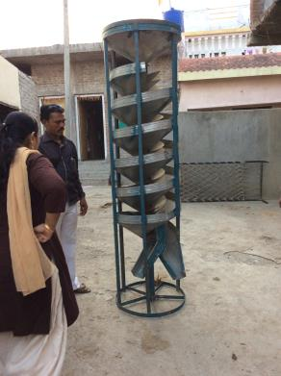
India Country Programme Evaluation
National Workshop
New Delhi, 12 May 2015

Slide 2
India / IFAD cooperation - snapshot
Largest IFAD portfolio. Since 1979, 31 loans (US$ 928m)
Total estimated portfolio costs: US$ 2.6 billion (1979-2015)
IFAD country office since 2001. Country programme manager out-posted in 2016

Slide 3
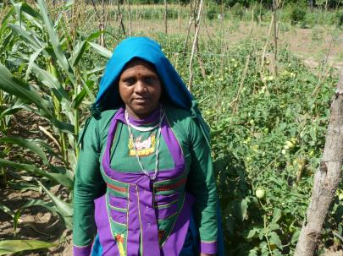
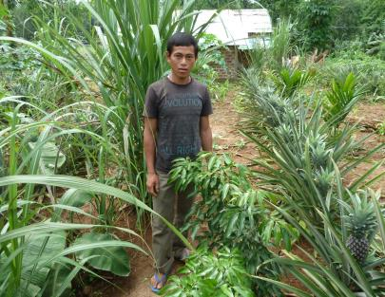
This Country Programme Evaluation
Second in India (previous in 2009)
Three levels of analysis:
portfolio of loans;
non-lending activities;
strategy (COSOP)
CPE period: 2010-15
13 loan-projects reviewed
sample of 6 grants

Slide 4
Current strategy (COSOP 2011-16)
Objectives: Increased rural poor people’s access to: (i) agricultural technologies and natural resources; (ii) financial services and value chains
Target groups: (i) tribal communities; (ii) smallholder farmers; (iii) landless people; (iv) women; and (v) unemployed youth
Areas of innovation: (i) renewable energy; (ii) resilience to climate change; (iii) remittances and microinsurance; (iv) fair and effective value chains; (iv) ICT

Slide 5
The projects reviewed
Cohort | Project Names
A. Closed | 1. Jharkhand-Chhattisgarh Tribal Development Programme (JCTDP) 2. Livelihoods Improvement Project in the Himalayas (LIPH) 3. Women’s Empowerment & Livelihoods in mid-Gangetic Plains (WELP)
B. On-going Approved 2002 -2009 | 4. Orissa Tribal Empowerment and Livelihoods Programme (OTELP) 5. Tejaswini Rural Women's Empowerment Programme 6. Post-Tsunami Sustainable Livelihoods Programme (PTSLP), Tamil Nadu 7. Mitigating Poverty in Western Rajasthan Project (MPOWER) 8. NE Region Community Resource Mgmt Project– II (NERCORMP II) 9. Convergence of Agric Interventions in MH Distressed Districts (CAIM)
C. On-going Approved since 2011 | 10. Integrated Livelihood Support Project (ILSP), Uttarakhand 11. Jharkhand Tribal Empowerment and Livelihoods Project (JTELP) 12. Meghalaya Livelihoods and Access to Markets Project (LAMP) 13. Odisha Particularly Vulnerable Tribal Groups Empowerment

Slide 6
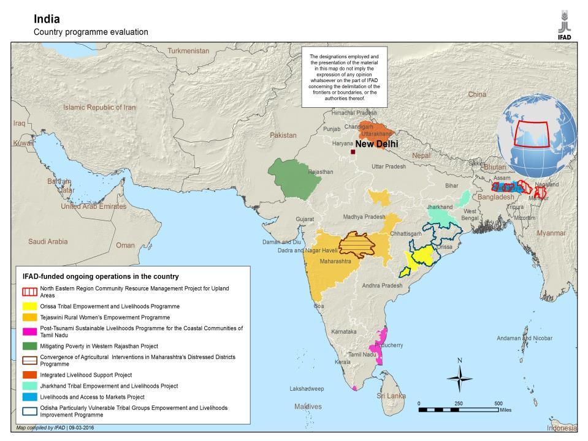

Slide 7
Thematic breakdown of project costs
Thematic Area Clusters | Percentage of total
Agricultural, livestock, production, extension & natural resource management | 35%
Rural financial services | 28%
Community mobilization, community-driven services and infrastructure | 12%
Post-harvest, market access and rural enterprises | 12%
Capacity building of public institutions and policy | 5%
Programme management and M&E | 8%
Total | 100%

Slide 8
Grants reviewed
Recipient | Topic
ICRISAT | Sustainable management of crops in rain-fed Asia
Bioversity | Reinforcing resilience of poor rural communities through on-farm conservation
CIP | Root and Tuber Crops for Food Security in Asia and the Pacific
ICRAF | Programme for the Development of Alternative Biofuel Crops
IFPRI | Collaborative research and capacity strengthening for M&E of IFAD projects in India and Bhutan
Tebtebba Found. | Reclaiming the Commons with Women’s Power

Slide 9
Findings: Portfolio Relevance
Traditional emphasis: highly disadvantaged areas and groups
Basic needs (health & sanitation, food security)
Empowerment
Natural resource, land scarcity
Efforts towards convergence with public programmes (NRLM, MNREGS) and link with PRIs’ local plans
Past agricultural component design paid limited attention to:
- Farming system analysis
- Production clusters, linkages to markets, value chains
- Collaboration opportunities with local research centres

Slide 10
Portfolio – Effectiveness and Efficiency
Effectiveness
As of 2015 on-going projects covered 1.9m hh (102 % of target)
Better established results in community mobilization, basic infrastructure
Emerging results in agric production, access to financial services
Efficiency
Slow project start-up time (16 months on average), slow implementation and loan disbursement
Challenging target areas, demanding multi-component design
Capacity issues of state implementing agencies, problems of staff retention, complicated procurement

Slide 11
Impact
Advancements under: (i) household income and assets and (ii) human and social capital
Household incomes: Some examples (2014-15)
Indicator | Project | Estimated difference with / without
Income changes | - Jharkhand Chhattisgarh - CAIM / MH | +25%* +50%
Proportion of hh reporting income increase | - NE Region - Tejaswini - LIPH / Uttarakhand | +33% +22% +37%

Slide 12
Impact - 2
Human and social capital
Knowledge of improved crop varieties and techniques
Group mobilization, collective action
Knowledge of other public programmes, opportunities
Women running in PRI elections
Agricultural productivity and food security: emerging evidence of yields increase
Low-cost extension (community resource persons)

Slide 13
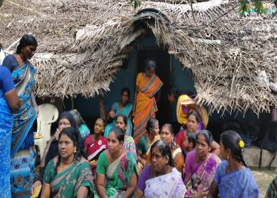
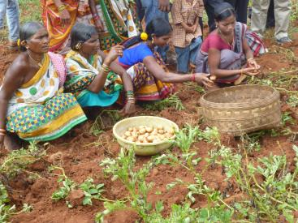
Gender equality
Women’s exposure to village committees, federations, local elections
Initiatives to reduce drudgery (water points, water harvesting, agricultural tools and equipment)
Initiatives to curb violence, alcoholism, gambling: (i) Shaurya Dal (MP) and (ii) paralegal workers (MH)
Enhanced women’s decision making in household investment and consumption

Slide 14
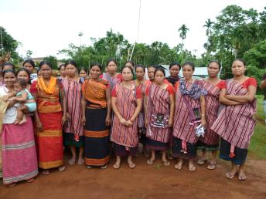
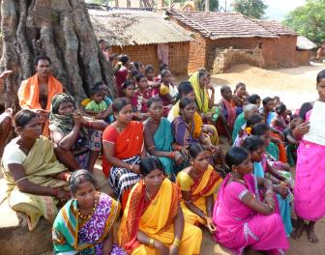
Sustainability
Social sustainability. Quest for emancipation, better livelihood likely to continue
Variation in capacity of grassroots organizations (dormancy)
Generally good support from state-level policy makers
Past project design had little focus on market linkages, value addition. Better awareness in recent projects

Slide 15
Scaling Up
1) Expanding outreach through national/ state or donor funding - tribal areas
NE Region (national Gov, WB)
Odisha (state Gov)
2) From project to state policies – approaches to stem domestic violence
Maharashtra and Madhya Pradesh
3) From project to larger public programme
Uttarakhand and Tamil Nadu (NRLM)

Slide 16
Non-lending activities
Knowledge management
Communication material (project websites, brochures and booklets)
Project experiences under-analysed, (e.g. SHG-bank linkages, contract farming pilots)
Limited partnership with think tanks / universities on policy issues
Partnerships
Strong with DEA-MoF and state-level agencies; weaker with technical central level ministries (Agric, Rural Dev, Tribal Affairs)
Limited with international org. (IFIs, UN)
Long tradition with NGOs; pilot experiences with private companies

Slide 17
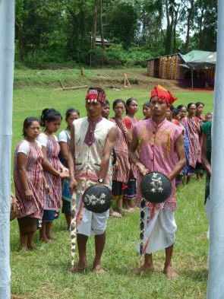
Non-lending activities
Policy engagement
Growing interest at state and central level in learning from operational experience to improve design and implementation of public policies and programmes
Some IFAD-funded projects informed state programmes and policies (e.g. Odisha, Maharashtra, Madhya Pradesh)
But gaps in systematizing experiences
Limited resources with country office for policy-related work and events

Slide 18
Strategic issues - highlights
Across project generations, IFAD commitment to target poorest areas, socio-economic groups remained strong
Traditional project designs did not address sufficiently rain-fed agriculture development, linkages to markets and value chains.
Portfolio overall solid but implementation delays
Geographical spread of portfolio still wide, straining limited country office resources
Imbalance between lending and non-lending efforts. Growing national demand for the latter

Slide 19
Main Recommendations
1. Continue priority for disadvantaged areas and groups but differentiate the approaches according to target groups and initial conditions
2. Project design to focus more explicitly on :
- rain-fed agriculture;
- territorial / product clusters and marketing
- cooperating with national and local agric.research centres
3. Complementary interventions in processing, value addition, marketing, eco-tourism

Slide 20
Recommendations - 2
4. Address portfolio implementation issues
Simplify design: (smaller areas; modular approach)
Review staff turnover, procurement bottlenecks
Support capacity of implementing agencies (guidelines, training)
5. Strengthen partnerships: (i) state gov.; (ii) central gov.; (iii) private sector; (iv) south-south cooperation
6. Enhance capacity and resources for non-lending activities
Embed KM and policy dialogue in project components
Expand scope of portfolio review meetings
Establish partnership with national / international think tanks

Slide 21
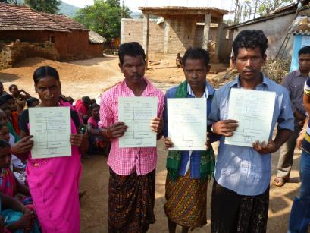
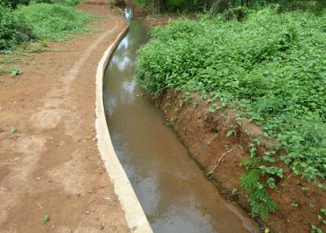
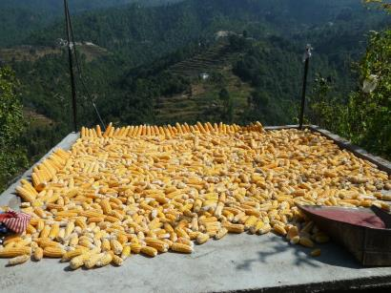
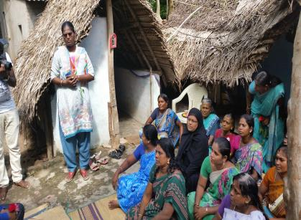
Thank you
For your attention !

