Slide 1
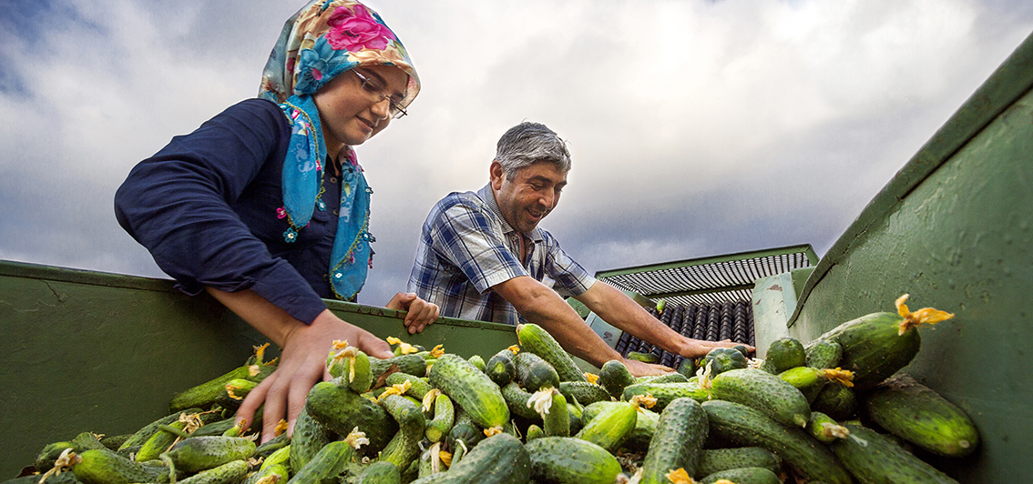
Turkey Country Programme Evaluation-2015:
Main findings and Recommendations
National Round-table Workshop
Ankara, Turkey- 28 January 2016

Slide 2
IFAD-Turkey Cooperation.
Total number of approved loans: 10
Total value of portfolio: USD 661.1million
IFAD loans: USD 189 million
Counterpart funding (Contribution from Government and beneficiaries): US$ 323.3 million
Co-financing: US$ 148.8 million
On-going projects:2
CPE covers IFAD – Turkey partnership from 2003-2015, inter-alia,4 projects, 2000 & 2006 COSOP, and country programme management

Slide 3
Evaluation 2015 – Objectives/Methodology
Objectives
Assess the performance an impact of IFAD-supported operations in Turkey.
Generate findings and recommendations to enhance the country programme’s overall development effectiveness.
Provide relevant information and insight to inform the formulation of the future Country Programme Opportunities Strategy (COSOP) by IFAD and the Government.
Methodology
CPE assesses: (i) project portfolio performance; (ii) non-lending activities including grants and SSTC; (iii) performance of the 2000 and 2006 COSOP.
A variety of data collection methods used and triangulation.

Slide 4
Process
Preparatory phase (April-May 2015): approach paper and preparatory mission.
Desk review (May-June): preparation of desk review notes, identification of hypotheses and issues to explored in the course of the evaluation.
CPE main mission (July): a multidisciplinary team of experts visited all current projects and held a wrap up mission in Ankara.
Analysis, report writing and peer review (September-November)
CPE national roundtable workshop (January 2016)

Slide 5
Main findings
General
Valued and strategic partnership can be strengthened and adjusted.
Partnership needs to better reflect Turkey’s MIC status.
Key pillars of future partnership: SSTC, Innovation, Knowledge Sharing.
Relatively small IFAD financing, but highly valued at local level and important for addressing poverty pockets.
Need to improve IFAD visibility in the country to facilitate better dialogue and strengthen partnerships.

Slide 6
Main findings (cont.)
Country Strategy
Good alignment of country strategic objectives with IFAD and government policies and priorities.
Consistent and understandable geographic focus on Turkey's lagging regions. Focus on southern and eastern Anatolia appropriate.
Targeting approach has become diffuse rather than focused on the rural poor. Local, particularly household level targeting could be further refined.
New and additional focus on natural resources management- from previous strategic thrust in agriculture commercialization with strong area-based targeting approach.

Slide 7
Main findings (cont.)
The project Portfolio
Project objectives consistent with the government priorities; relevant focus on commercial agriculture, but challenges with targeting poor farmers, women and youth.
Effectiveness is mixed. Improvement in the incomes, agricultural productivity and commercialization; modest gains in rural employment and self-sustaining institutions of the rural poor.
Investments well-managed and cost-effective (infrastructure highly efficient) but efficiency offset by limited replication of new agricultural technology demonstration effect, and implementation delays.

Slide 8
Main findings (cont.)
The project Portfolio
Sustainability of benefits requires attention –limited by weak operation and maintenance and insufficient collaboration with the rural financial sector.
The M&E function has been consistently a low performing area for the programme.
Promotion of gender equality is moderately unsatisfactory. Participation and benefits achieved for women in terms of empowerment has been limited.
Some valuable innovations introduced, but they were mostly incremental, and evidence of scaling up was limited.

Slide 9
Main findings (cont.)
Non-lending activities
Partnerships with implementing agencies at central/provincial levels is very good. Limited with policy-level government partners, cooperating partners, NGOs and the private sector.
Policy engagement has been overall limited. Conducted mainly through the COSOP and the projects, within a narrow circle (two main implementing agencies).
Several valuable knowledge management activities carried out, but overall no systematic effort to collect, document and disseminate lessons and best practices. IFAD's visibility in Turkey remains limited.
IFAD support to SSTC in Turkey is incipient -yet to provide an adequate response to Turkey’s interest and capacity in this area.

Slide 10
Five main conclusions
Over the past 13 years the Fund has made a positive contribution to agriculture and rural development in Turkey. The overall results of the partnership have been moderately satisfactory.
The long-standing IFAD-Turkey partnership remains strategically important for both IFAD and the Government of Turkey.
Access to project benefits remains a challenge for poorer farmers, women and youth – of particular concern in a growing income disparity context.

Slide 11
Five main conclusions (cont.)
There is demand for IFAD to be a more active player in sharing international best practices in Turkey -additional value to the partnership.
Positive signs in the evolution of the programme: IFAD country office in Turkey; openness to new partnerships; new investments; recent progress in SSTC.

Slide 12
Five strategic recommendations
Prepare a new COSOP with a proper analysis of IFAD’s strengths and limitations in Turkey and the opportunities and threats it faces in building more effective partnerships with the Government and others.
Improve targeting, particularly for poorer farmers and specific target groups, including women and youth. Sharply define M&E systems to track participation and benefits.
Strengthen non-lending activities (partnerships, knowledge management, policy dialogue) and ensure synergies with the portfolio.

Slide 13
Five strategic recommendations
Emphasize innovation and scaling up as key strategic priorities.
Strengthen the strategic focus on women and youth. Focus on gender equality and women’s empowerment and direct targeting of youth.

Slide 14
Next Steps in the CPE
Agreement at Completion Point. February 2016
Final CPE report published. March 2016
Discussion in IFAD Evaluation Committee. 29-30 March 2016
Discussion in IFAD Executive Board. 13-14 April 2016

Slide 15
Thank you for your attention

Slide 16
Working Groups
Working Group 1
The role and priorities of IFAD (e.g. in terms of thematic and geographic coverage) in Turkey.
Facilitator: Mr. Doğan AKAR, Sivas Erzincan Development Project Regional Administrator
Rapporteur

Slide 17
Working Groups
Working Group 2
The opportunities and challenges for IFAD to further enhance its non-lending activities (knowledge management, policy dialogue, partnership-building, south-south cooperation) in support of enhancing its performance and rural transformation in the country.
Facilitator: Mr. Murat ÇEVİK Ardahan-Kars-Artvin Development Project Regional Administrator
Rapporteur

Slide 18
Working Group
Working Group 3
Targeting approaches and strategies to ensure inclusiveness and equal opportunities for the rural poor throughout the IFAD-supported programme.
Facilitator: Mr. Mehmet Aydın BELGE, Responsible for Instrument for Pre-Accesion Assistance Rural Development Programme of EU
Rapporteur:

