Slide 1
How IFAD Promotes Learning among Development Partners in the Field
Oscar A. Garcia
Director, Independent Office of Evaluation of IFAD
Johanna Pennarz
Lead Evaluation Officer, Independent Office of Evaluation of IFAD
UNEG webinar - 15 November 2016

Slide 2
Independent Office of Evaluation (IOE):
What we do
IOE conducts independent evaluations of IFAD-financed policies, strategies and operations to promote accountability and learning. The main purpose is to contribute to improving IFAD’s and its partners’ performance in supporting rural transformation in development Member countries.
Mission: To promote accountability and learning through independent, credible and useful evaluations of IFAD’s work.
Vision: Increasing the impact of IFAD’s operations for sustainable and inclusive rural transformation through excellence in evaluation.

Slide 3
IOE evaluation process
Preparatory phase
Main evaluation phase, including field mission, data collection and analysis
CSPE coincides with IFAD planning to inform future COSOP
Includes forming a Core Learning Partnership (CLP) of in-country stakeholders
Core learning partnership
Follow up: Tracking evaluation recommendations
Finalization, including national workshop
Agreement at Completion Point (ACP) signed by IFAD Management and Government
Dissemination of evaluation findings (Print, online, learning events, external presentations)
President’s Report on the Implementation Status of Evaluation Recommendations and Management Actions (PRISMA)
Presentation to the Executive Board
Stakeholder consultation and feedback
Beneficiary feedback/ surveys

Slide 4
IOE’s core learning partnership
Core learning partnership (CLP), for corporate-level and country strategy and programme evaluations, evaluation synthesis reports, impact and project performance evaluations.
The CLP members contribute to the evaluation process from the outset (design) and throughout the different stages of the evaluation.
Knowledge is generated through the evaluation process and shared among the CLP members.

Slide 5
IFAD Management’s response system
IFAD Management’s response for all types of evaluations, except:
Country strategy and programme evaluation: prepare an
Agreement at Completion Point (ACP)
The ACP presents main evaluation findings and
recommendations
Signed by Government and IFAD - Programme Management Department; agree to adopt and implement recommendations within a specific timeline.

Slide 6
IFAD Management’s response system
The President’s Report on the Implementation Status of Evaluation Recommendations and Management Actions (PRISMA).
IOE provides comments on the PRISMA and documents are presented to the Executive Board (e.g. ACP, PRISMA, IOE comments).
The aim is for evaluations to finish not merely with a publication, but with an understanding among evaluation’s partners to adopt specific findings and recommendations.

Slide 7
Tracking recommendations to strengthen learning, transparency, and accountability
Executive Board
Evaluation Recommen-dations
Management’s Response/ Agreement at Completion Point
PRISMA
Management
Management
IOE
Comments

Slide 8
Learning workshops
Learning workshops are organized as a final step in the evaluation process for the following types of evaluations:
█ Impact evaluation: in-house and national workshop
█ Country strategy and programme evaluation (CSPE): national workshop
█ Corporate-level evaluation: In-house and sometimes
in-country workshops
█ Evaluation synthesis report: In-house workshop
█ Annual Report on Results and Impact of IFAD Operations (ARRI): In-house workshop

Slide 9
National workshops for CSPEs
Workshop participants include representatives from central and provincial/state governments, staff of IFAD-funded projects, beneficiaries, bilateral and multilateral aid institutions, non-governmental and civil society organizations, key private sector actors, research institutions and selected resource persons.
India Country Programme Evaluation national workshop

Slide 10
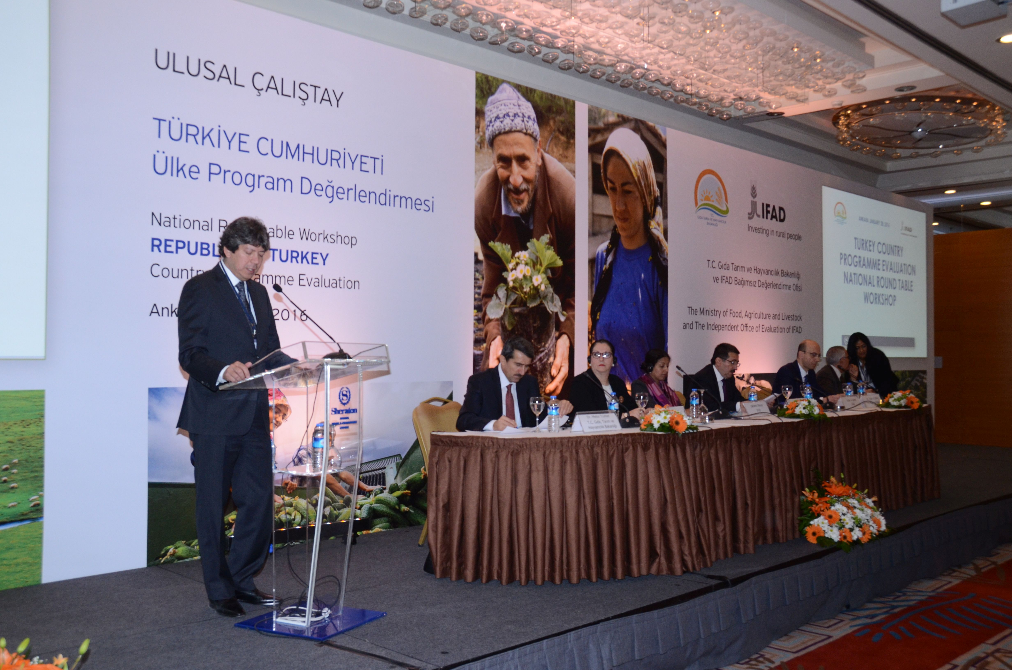
National workshops for CSPEs
The event is organized at the national level to:
Discuss and deepen the participants’ understanding of the evaluation findings and recommendations.
Lay the groundwork for the future partnership between IFAD and the concerned country.
Nigeria Country Programme Evaluation national workshop
Turkey Country Programme Evaluation national workshop

Slide 11
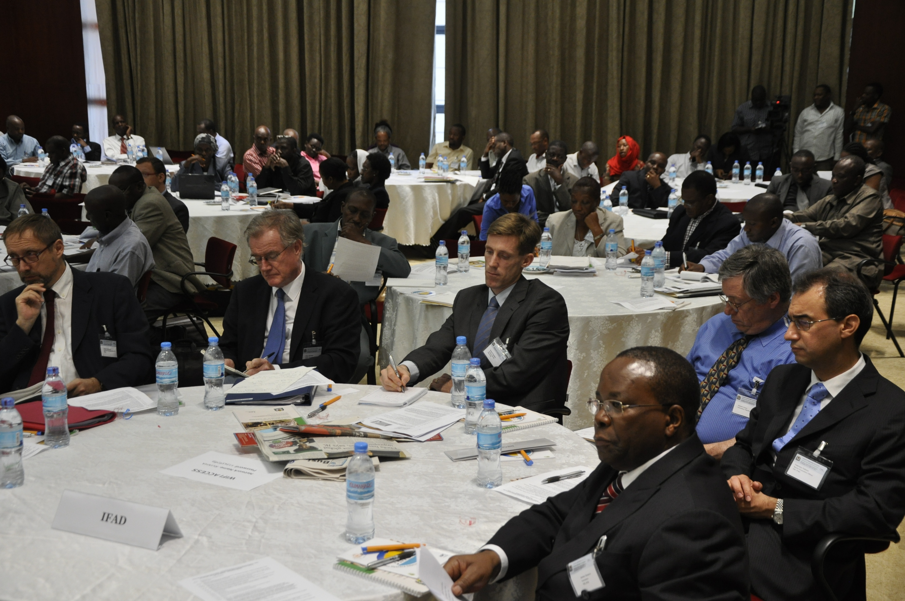
National workshops for CSPEs
Provide inputs for the preparation of the evaluation’s agreement at completion point.
Brazil Country Programme Evaluation national workshop
Tanzania Country Programme Evaluation national workshop

Slide 12
Agenda for CSPE national workshops
Introductory statements by IOE Management, government officials and IFAD Management
Presentation of evaluation findings and recommendations
Plenary
Break out into three working groups. Each group considers one workshop theme
Plenary reconvenes
Reflections on future directions and closing statements

Slide 13
Examples of CSPE national workshops themes
Examples of workshop themes: Brazil
1. The role and priorities of IFAD (e.g. in terms of thematic and geographic coverage) in Brazil as a middle-income country.
2. Opportunities and challenges for IFAD to further enhance its non-lending activities (knowledge management, policy dialogue, partnership-building) in support of rural transformation in the country.
3. IFAD’s contribution to South-South and triangular cooperation in Brazil focused on family farming, in co-operation with other development partners.

Slide 14
Examples of CSPE national workshops themes
Examples of workshop themes:Tanzania
Combining financing modalities to support inclusive rural growth and poverty reduction in Tanzania.
Emerging public-private-producer’s partnership opportunities and strategies for IFAD to support agriculture and livestock value chain development in Tanzania.
Developing more effective partnerships for scaling up IFAD supported initiatives and for policy dialogue.

