Slide 1
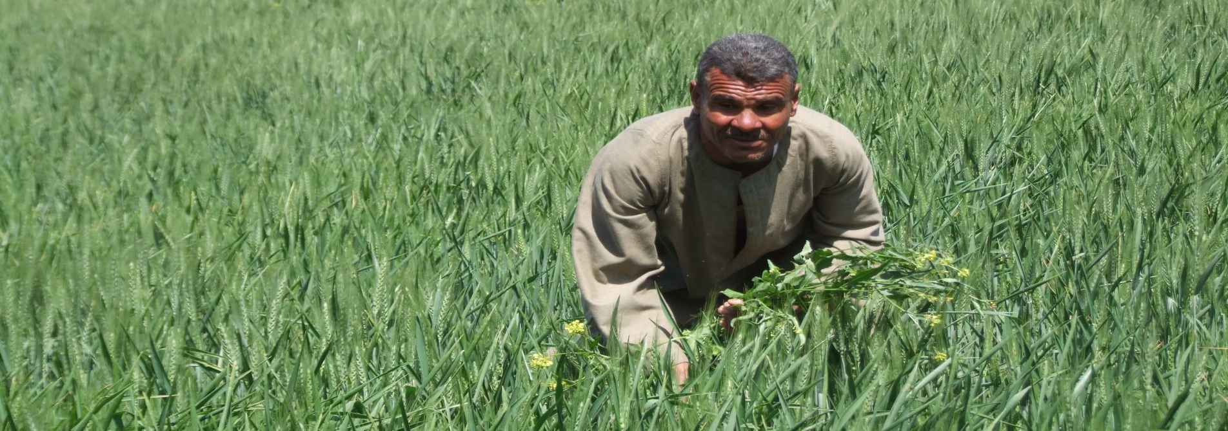
The role of partnerships and stakeholders
The case of the IFAD – Egypt partnership on country programme evaluation
Presentation at EES 2018, Greece

Slide 2
Context
Partnership commitments (Paris, Busan)
Mutual accountability as important partnership principle
Evaluation capacity development as a commitment of the global evaluation community
Conducting (joint) evaluation as practical approach

Slide 3
IFAD IOE
Independent Office of Evaluation of IFAD
Independent evaluation function
Conducting 5 Country Strategy and Programme evaluations every year
Committed to evaluation capacity development

Slide 4
Egypt MIIC
Ministry of Investment and International Cooperation
Charged to develop and implement a government-led M&E system
Role in coordinating, monitoring and evaluating the implementation of the Agenda 2030 –in particular the roles and contributions of international and national development partners.
MIIC M&E Department expanding its role from project evaluation to strategy and thematic evaluation.
Funding to the M&E unit to conduct their own - parallel - evaluation of IFAD's CSPE.

Slide 5
Two parallel evaluations
Purpose
To provide evidence to guide the design of the new COSOP
Take stock
Document achievement and failures
Address challenges
Document lessons learned

Slide 6
Two approaches - IOE
CSPE to inform new strategic cycle
Assessed relevance and effectiveness of IFAD’s country strategy
Covered non-lending activities (policy engagement, knowledge management, partnerships)
Rated standard DAC criteria and IFAD specific criteria
Structured report according to evaluation criteria
Conducted in-depth evaluation of one project as input into CSPE

Slide 7
Two approaches - MIIC
Conceived CSPE as a thematic evaluation
Assessed performance according to thematic areas (rural finance, irrigation, rural marketing, research and development and gender)
Focused on the economic and social effects of different interventions
Rated performance within thematic areas according to DAC evaluation criteria
Structured report according to thematic areas
Conducted in-depth evaluation of one project as input into CSPE

Slide 8
Process
Preparatory meeting (joint)
Project evaluations (separate)
Field missions (separate)
Meeting to share experiences (joint)
Commenting on draft report (mutual)
Stakeholder workshop to present findings (joint)

Slide 9
CSPE Conclusions- IOE
Overall performance moderately satisfactory
High degree of continuity and focus in country programme
Concentrated and focused approaches effective in addressing poverty issues on a smaller scale.
Investment in capacity building insufficient
Knowledge and experiences not adequately captured; not used to enable progressive learning.
Partnerships were limited and coordination was weak

Slide 10
CSPE Conclusions- MIIC
Thematic focus of IFAD’s country programme relevant
Rural finance recognised as main catalyst for rural development, but did not address actual demand
Agricultural research and extension not demand oriented
IFAD activities overlooked the different characteristics of the targeted women, especially with regards to education
Absence of situation analysis and needs assessment studies compromised the effectiveness of targeting.

Slide 11
Lessons
The evaluation has strengthened MIICs role in the coordination and oversight of development initiatives.
The “Jointness” made it easier for stakeholders to accept and internalise the evaluation findings.
For IFAD it was useful to see what aspects are important for our partners.
For MIIC: it was an opportunity to maximise the impact of development cooperation and promote national ownership, as well as a tool to inform future strategies.
The findings and recommendations of both reports contributed to policy dialogue among involved stakeholders and informed the new IFAD country strategy for Egypt.

